Slide 1
Red Light
Crossing on the street
Team Name : TTFF
Professor : Hwang Gyeongsun

Slide 2
Contents
01
Team Introduction
02
Program Introduction
03
Core Algorithms & Execution Result
04
Problem & Solution

Slide 3



Team Introduction
Lee Hanju(leader)
Ahn Hangil
Jung Chaeun
Player Design
Kinect Unity Connect
Game Planning
Overall Class Design
View Point Change
Overall Animation
Graphic Design
Tutorial Design
TrafficLight Design
Police Design
Car Design
Map Implement

Slide 4


Team Introduction
Hwang Seunghye
Hong Yeongseon
Extra Object Design
Map Design
Sound Design
Traffic Light Design
Police Implement
Car Implement
Map Implement

Slide 5
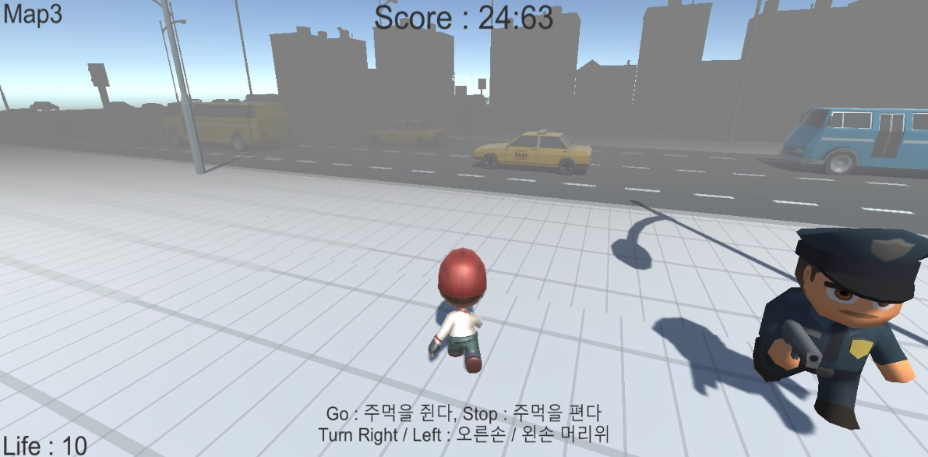
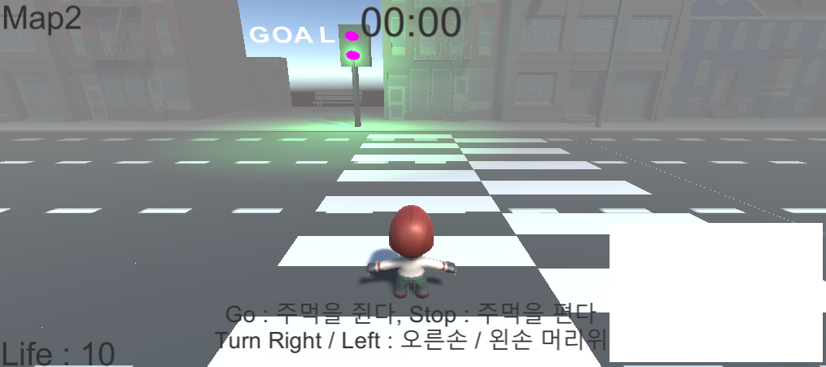
Program Introduction
Goal of Player
A player go to the GOAL point by crossing the road avoiding cars

Slide 6

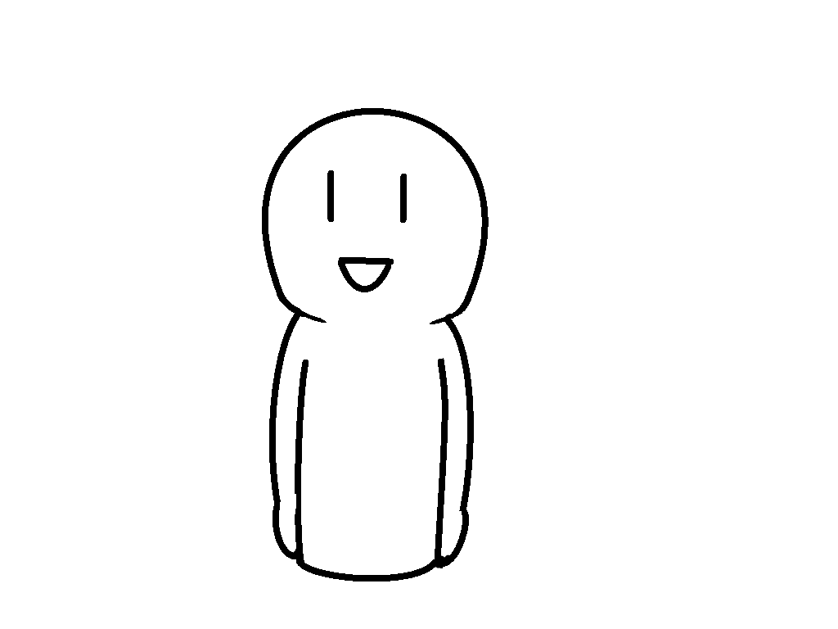

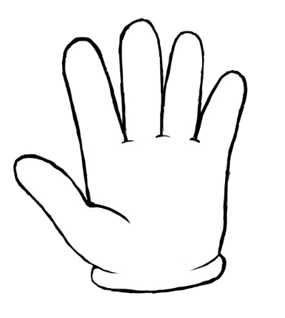
W
Program Introduction
How to play
Fist your hand to move forward
Open your hand to stop
Raise your arms in the direction you want to rotate

Slide 7
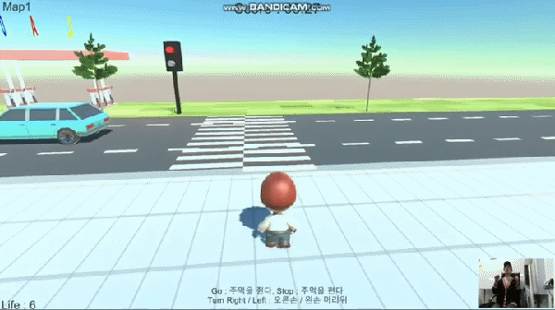
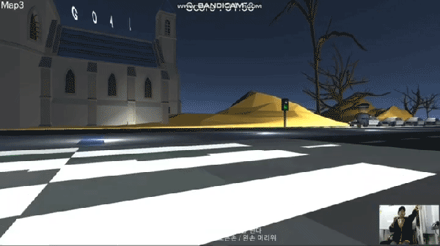
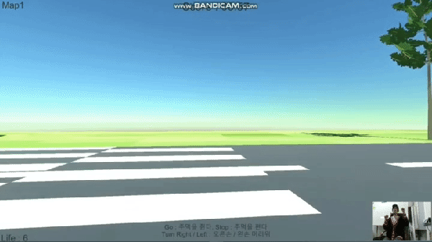
Execution Result

Slide 8
Core Algorithms
Player
Player.cs
if grab is true
playerstate=RUN
isMove=true
if high is true
playerstate=RUN
isRotate=true
PlayerState.cs
NORMAL
RUN
DIZZY
Hand.cs
set grab and high
and send them to Player
KinectConnet.cs
read body data form Kinnect
if grab your hand
set Hand.grab = true
if elbow is higher than shoulder
set Hand.Higt =true
PlayerMove.cs
if playerstate is RUN
Move or Rotate
other code
PlayerColider.cs
set playerstate by collision and trigger
PlayerAnimation.cs
Play animation by playerstate

Slide 9
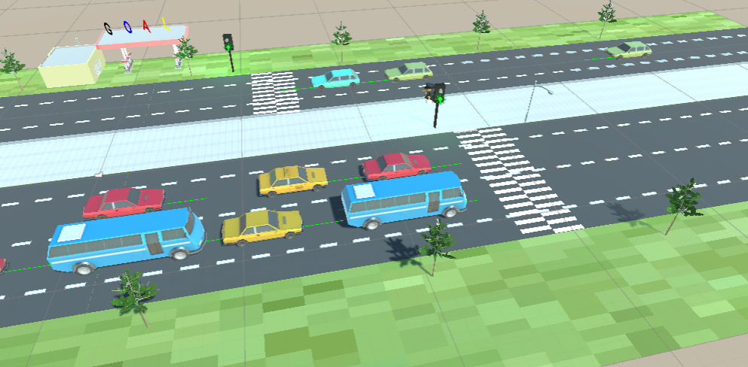
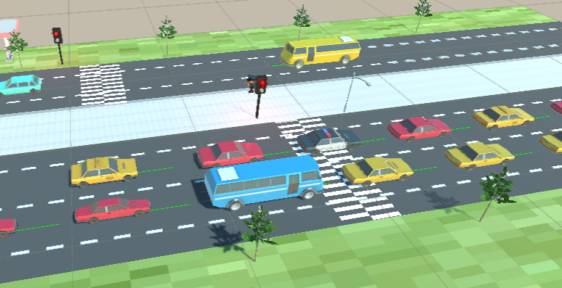
Execution Result
Green Light
Red Light

Slide 10
Core Algorithms
Car
Car.cs
CarState {MOVE STOP STAY}
Traffic-Light
TrafficLight.cs
set red-light time
set green-light time
TrafficLightState.cs
if cur-light time > red-light time
set light-color to green
set cur-light time=0
set car-Stop-Trigger active
set car-Go-Trigger inactive
else do opposite
CarMove.cs
If carstate is Move forward
CarColider.cs
If enter Go-Trigger
set carstate=MOVE
If enter Stop-Trigger
set carstate=STOP
Control car move by changing trigger state

Slide 11
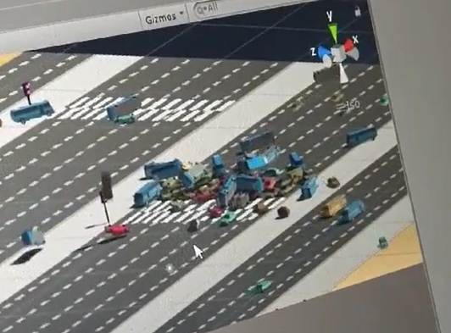
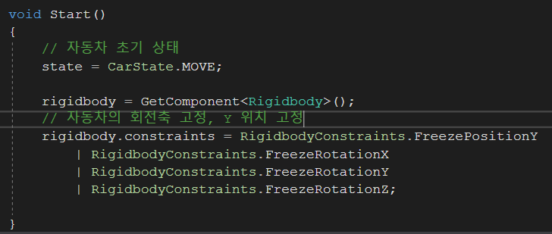
Problem and Solution
Problem
Car Crash Accident
Solution
Problem
Freeze RotationXYZ and PostionY
Resolution

Slide 12
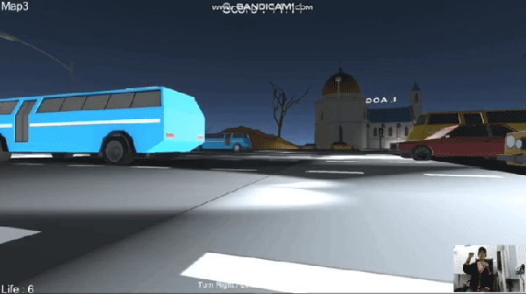
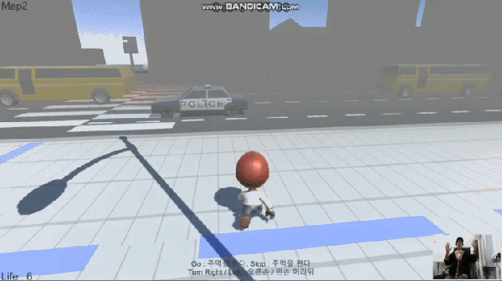
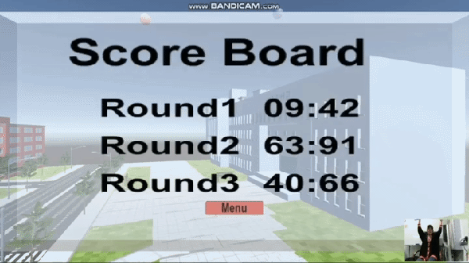
Extra Features
Hit Event
Police Collision
Score Board

Slide 13
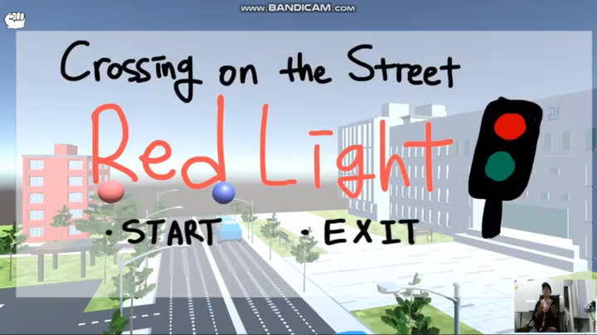
Demo Video

Slide 14
Q & A

